Slide 1
SysTick + Timer
Embedded System

Slide 2
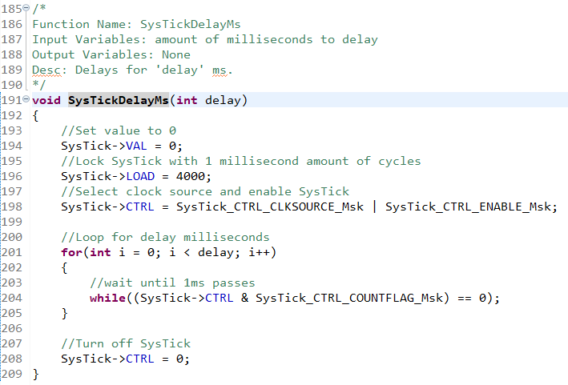
SysTick – function

Slide 3
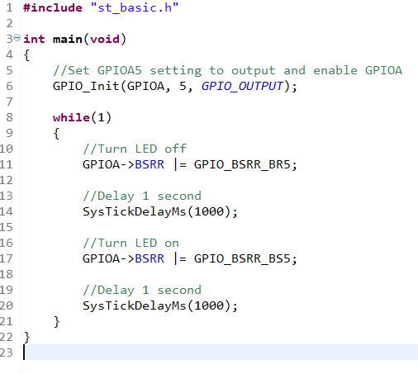
SysTick – main function

Slide 4
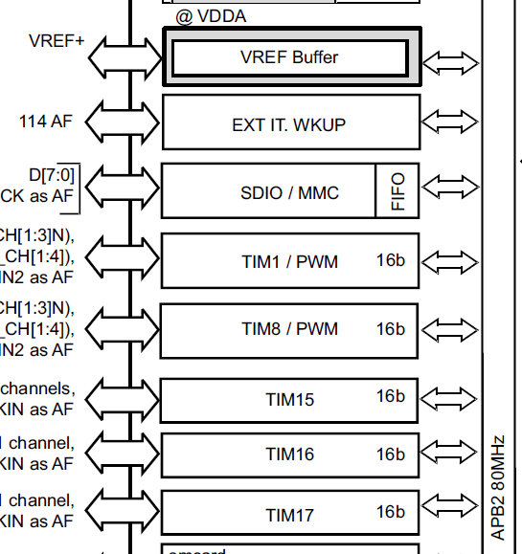
TIMER1 - Registers
Datasheet(page 17)
TIM1 connected to APB2

Slide 5
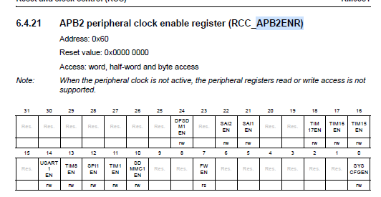

TIMER1 - Registers
Reference Sheet(page 258, 259)
Enable TIM1

Slide 6
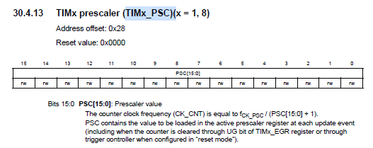
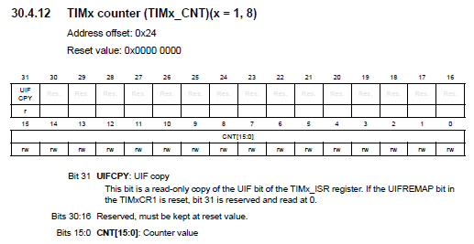
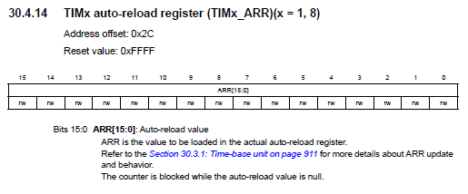
TIMER1 - Registers
Reference Sheet(page 990)
Divide input clock
Set cycles per increment
Set initial counter value

Slide 7
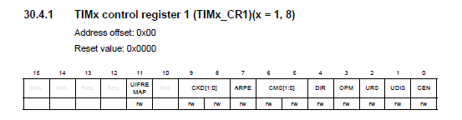

TIMER1 - Registers
Reference Sheet(page 969, 967)
Enable counter for TIM1

Slide 8
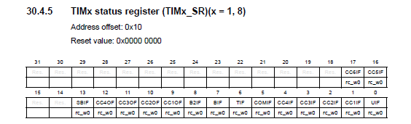
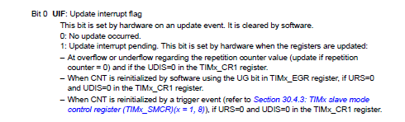
TIMER1 - Registers
Reference Sheet(page 969, 967)
Used to clear flag of update interrupt

Slide 9
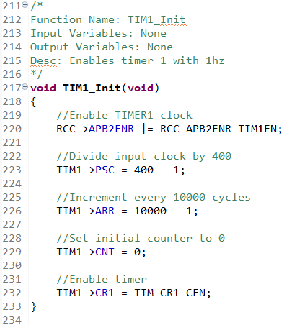
TIMER1 – function

Slide 10
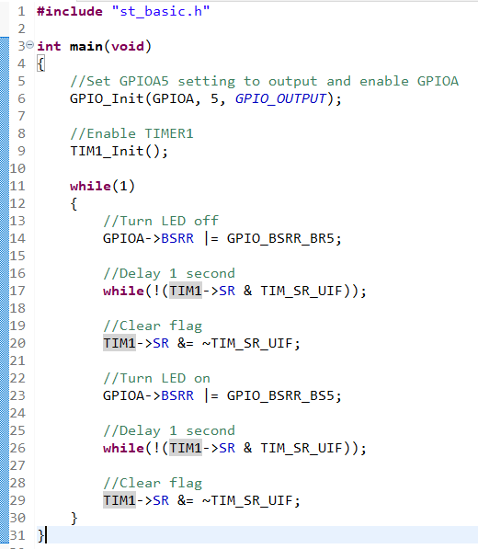
TIMER1 – main function

Slide 11
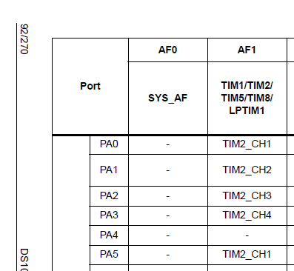
TIMER2 - Registers
Data Sheet(page 92)
PA5 connected with TIM2

Slide 12
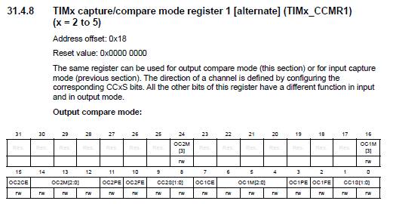
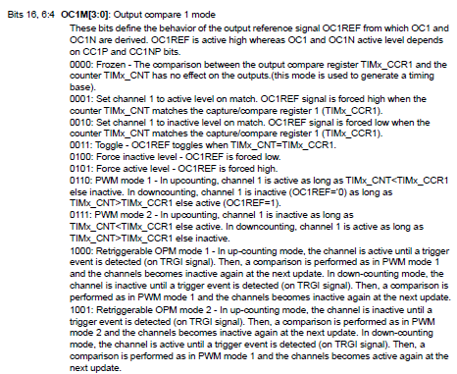
TIMER2 - Registers
Reference Sheet(page 1071, 1072)
Set to output compare toggle mode

Slide 13
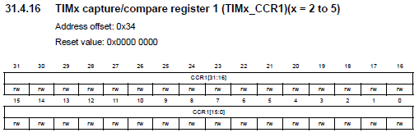
TIMER2 - Registers
Reference Sheet(page 1078)
Set match value

Slide 14
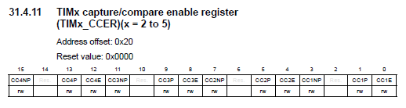
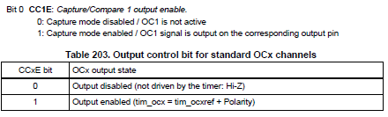
TIMER2 - Registers
Reference Sheet(page 1075, 1076)
Enable capture mode

Slide 15
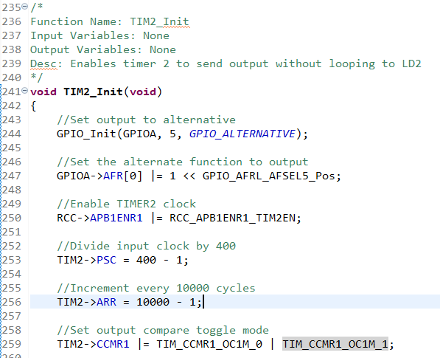
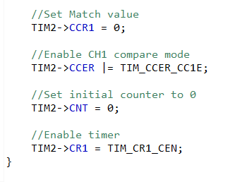
TIMER2 - function

Slide 16
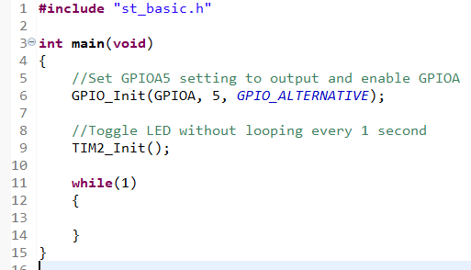
TIMER2 – main function

Slide 17
Task 1
Change timer1 to get a 100ms time for each cycle.

Slide 18
Task 2
Change timer2 to get a 10s time for each cycle.

